Slide 1

TEST-DRIVEN DEVELOPMENT

Slide 2
WHAT IS TDD?
Evolutionary Approach (Agile Software Development / XP)
Today a Software Engineering Standard
Combines Test-First Development with Refactoring
Test-First: write a test before you write just enough production code to fulfill that test!

Slide 3

Refactoring
Basic idea is that you make small code changes to improve the application design
Makes the code easier to understand and to modify.
Enables the code to evolve slowly over time
Takes an iterative and incremental approach to programming.
Notes:
Refactor: rename

Slide 4
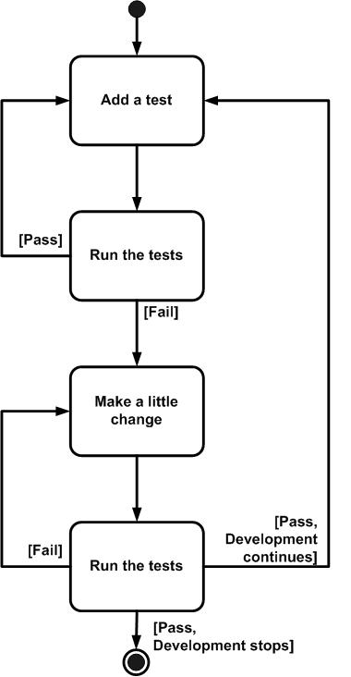
TFD STEPS
Test
First
Development

Slide 5
TDD = TFD + REFACTORING
Always determine if the existing design the is the best design possible!
If yes, continue with the TFD
Refuse to write a new function until there is first a test that fails
Notes:
Fail means you success and can write a new one

Slide 6

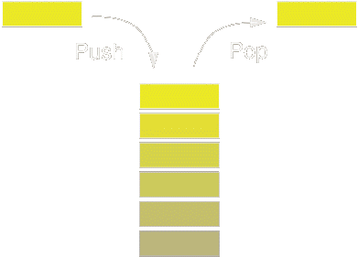
Practical TDD Example
Stack Class Implementation using
Test-Driven Development

Slide 7
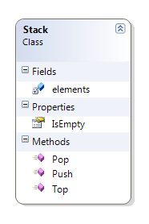
STACK
Simple Data Structure
Last-In First-Out (LIFO)
Allows Reading and Writing on the Top Element only.

Slide 8
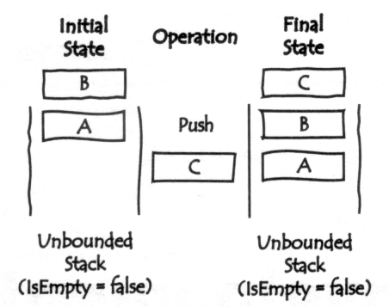
STACK – PUSH OPERATION

Slide 9
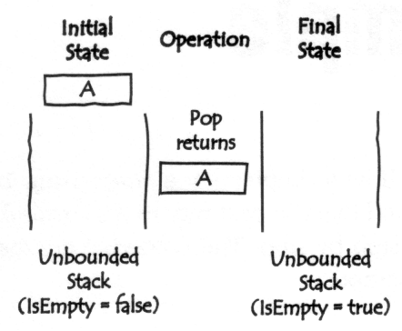
STACK – POP OPERATION

Slide 10
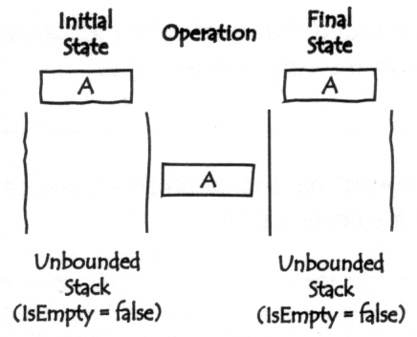
STACK – TOP OPERATION

Slide 11
Let’s get started…

